Slide 1
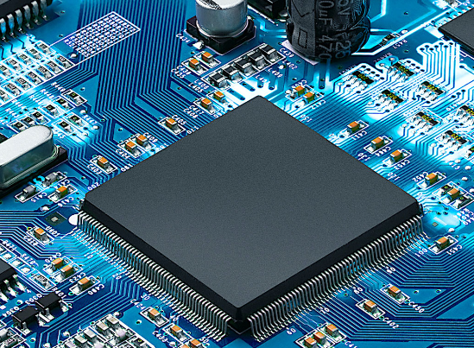


SYNCHONOUS SEQUENTIAL LOGIC
Presented By:
Shirajul Abedin Shimul
Reg No:2020338001
Md.Takoat Hossain
Reg No:2020338042
1

Slide 2
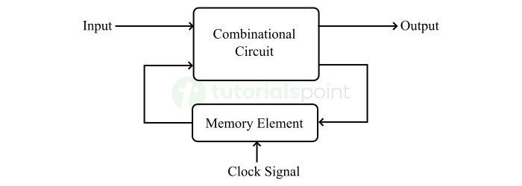
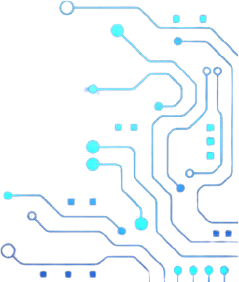
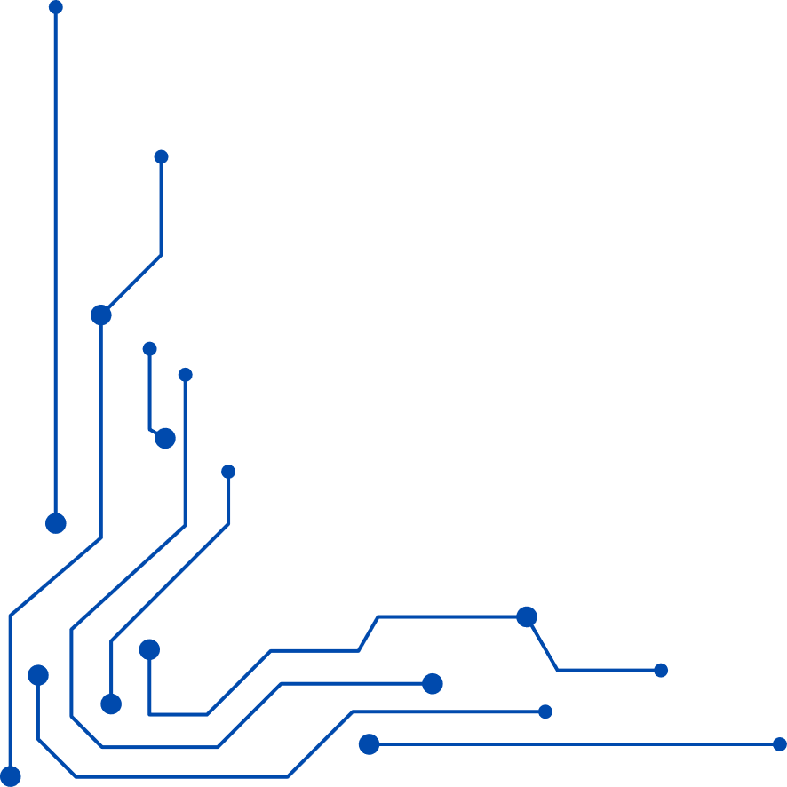
What is synchronous sequential logic ?
They are a type of digital circuit where changes in the output depend on both the current inputs and the previous state, controlled by a timing signal, usually a clock.
They are different from Combinational Logic Circuits as they implement storage elements in their operation
Block Diagram

Slide 3
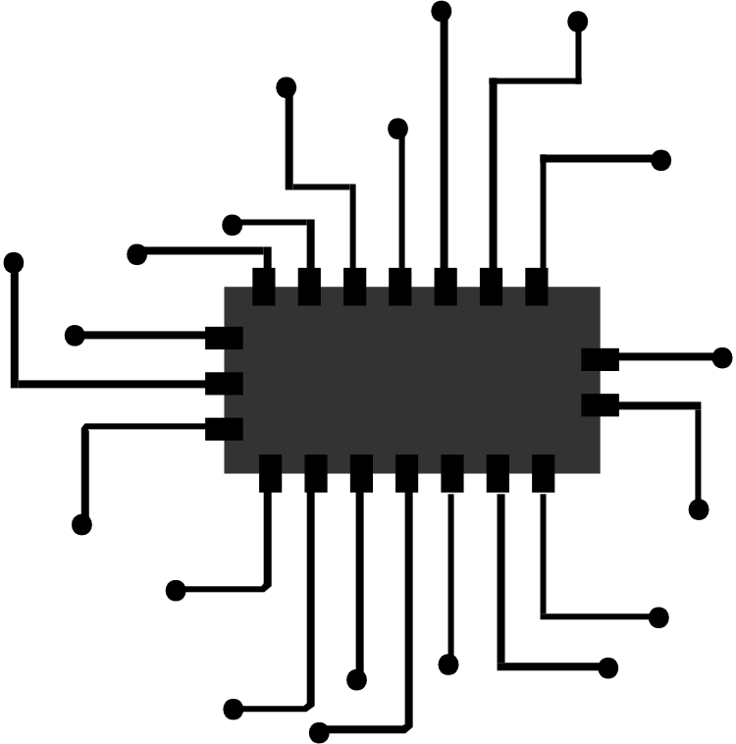
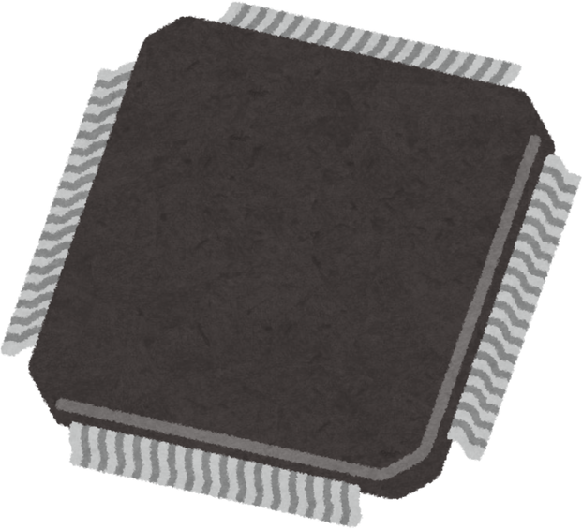
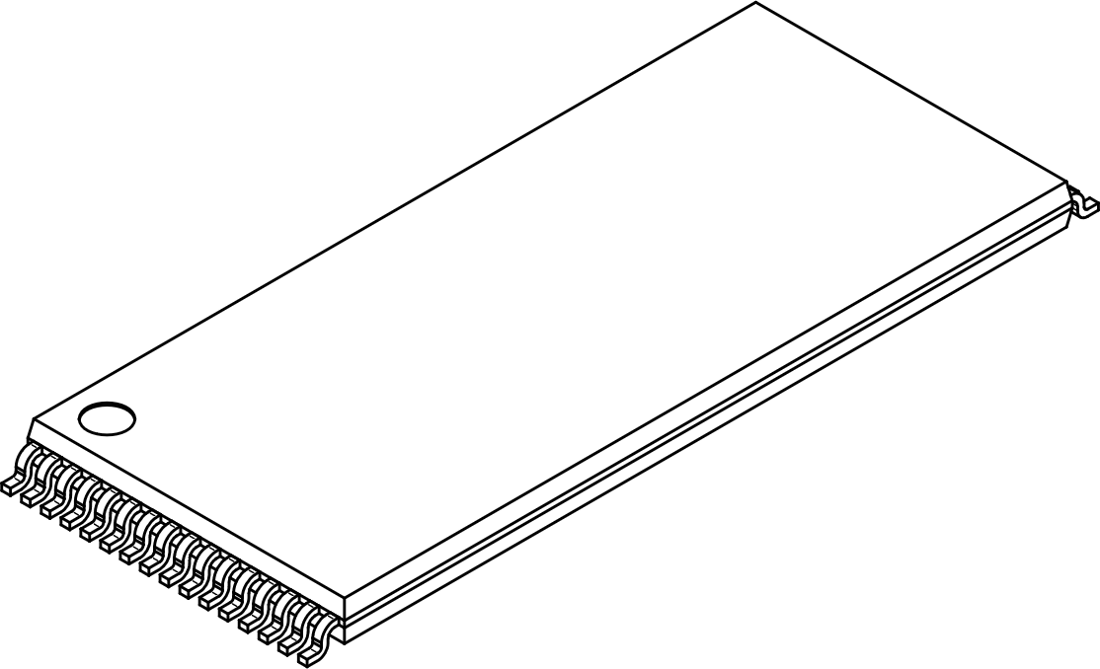
Key Components
Variety of components that make up for the design of the sequential circuit
They generally can include :
Triggering Method
Storage Elements
Time/Clock Signal
Latch
Flip-Flops
Counters
Registers
State machines

Slide 4
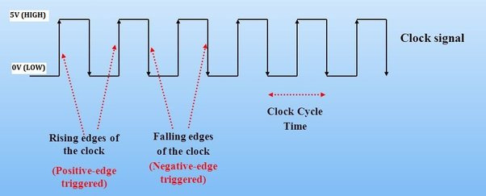
Clock Signal
T
A type of periodic waveform, usually a square wave, able to synchronize the operation of various components within a system. The clock signal alternates between high (1) and low (0) voltage levels,establishing a rhythm that dictates when certain operations, such as data transfer or computation
The signal includes the information of its own frequency,duty cycle,propagation delay and triggering(Positive/Negative)

Slide 5
Latch
Latches: What Are They?
Digital circuits called latches may store a single bit of data and maintain its value until fresh input signals refresh it. They serve as short-term storage components for binary data in digital systems. Several digital logic gates, including AND, OR, NOT, NAND, and NOR gates, can be used to build latches.
In digital systems, latches are frequently utilized for a variety of purposes, such as flip-flop circuits, control circuits, and data storage. State machines and memory components are examples of sequential circuits that are frequently implemented using them in conjunction with other digital circuits. .

Slide 6
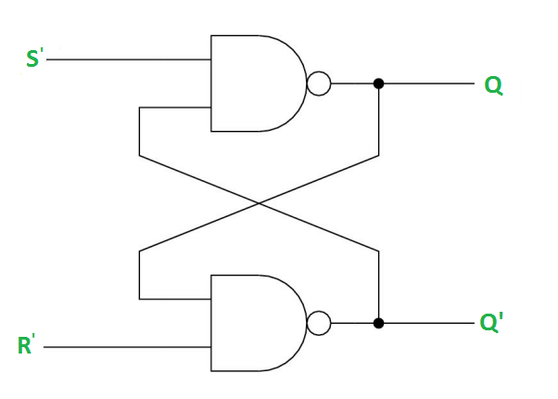
Types of Latches in Digital Electronics:
In digital electronics different types of latches are:
SR Latches
Gated SR Latches
D Latches
Gated D Latches
JK Latches
T Laches
The below logic diagram represents the SR latch using NAND gate:
Logic Diagram of SR Latch
SR Latch is a logic circuit with:
2 cross-coupled NOR gate or 2 cross-coupled NAND gate.
2 input S for SET and R for RESET
2 output Q, Q’.

Slide 7
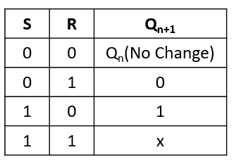
Truth Table of SR Latch:
The below table represents the truth table of SR latch.
7

Slide 8
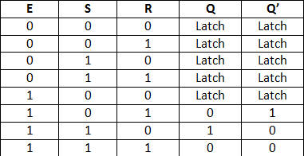
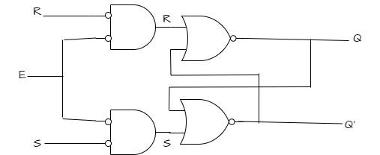
Gated SR Latch:
A Gated SR latch is a SR latch with enable input which works when enable is 1 and retain the previous state when enable is 0.
Truth Table of Gated SR Latch:
Logic Diagram of Gated SR Latch:
8

Slide 9
s
Flip Flops
Flip flops: What Are They?
The flip-flop is a circuit that maintains a state until directed by input to change the state. A basic flip-flop can be constructed using four-NAND or four-NOR gates. Flip-flop is popularly known as the basic digital memory circuit. It has its two states as logic 1(High) and logic 0(low) states. A flip flop is a sequential circuit which consist of single binary state of information or data. The digital circuit is a flip flop which has two outputs and are of opposite states. It is also known as a Bistable Multivibrator
Flip Flop Types:
There are 4 types of flip-flops in digital electronics:
SR Flip-Flop
JK Flip-Flop
D Flip-Flop
T Flip-Flop
9

Slide 10
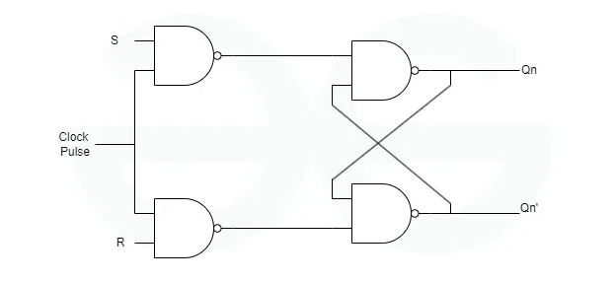
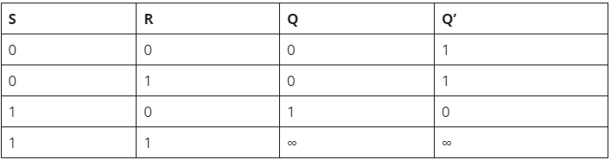
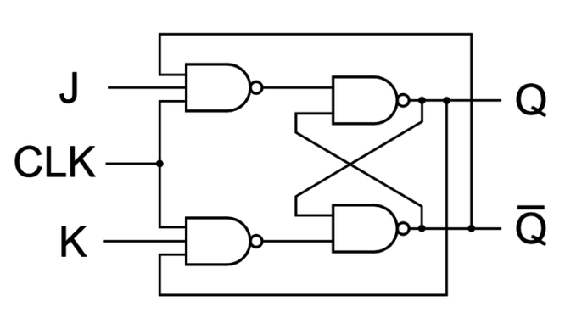
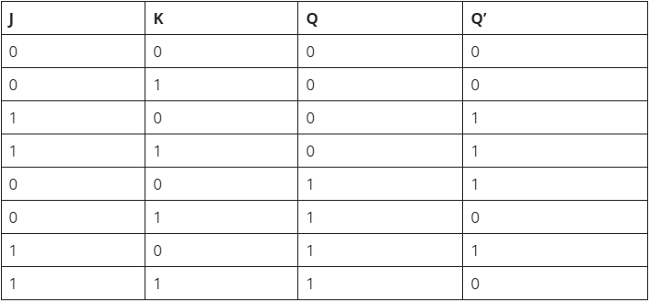
1. SR Flip Flop:
Circuit Diagram and Truth Table of S-R Flip Flop
2. JK Flip-Flop:
Circuit Diagram and Truth Table of JK Flip Flop
10

Slide 11
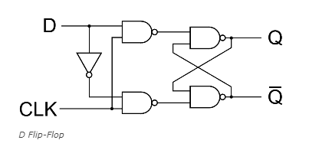
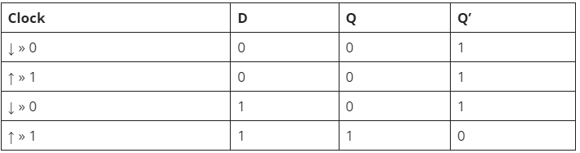
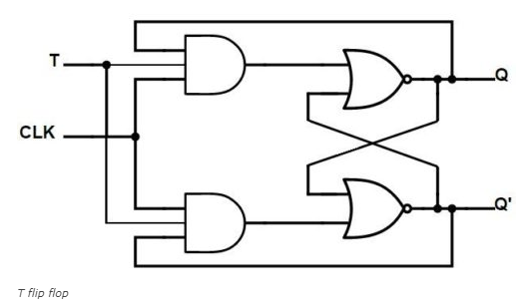
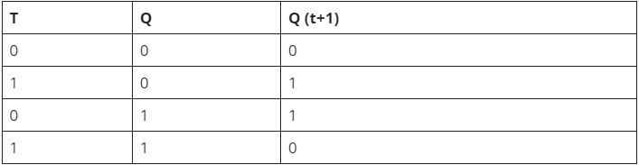
3. D Flip-Flop:
Circuit Diagram and Truth Table of D Flip Flop
4. T Flip-Flop:
Circuit Diagram and Truth Table of T Flip Flop
11

Slide 12
s
Counters
Let’s talk about counters..
A counter is a device which stores (and sometimes displays) the number of times a particular event or process has occurred, often in relationship to a clock signal. Counters are used in digital electronics for counting purpose, they can count specific event happening in the circuit. For example, in UP counter a counter increases count for every rising edge of clock.
Classification of Counters:
Counters are broadly divided into two categories
Asynchronous counter/Ripple counter:In asynchronous counter we don’t use universal clock, only first flip flop is driven by main clock and the clock input of rest of the following counters is driven by output of previous flip flops.
12

Slide 13
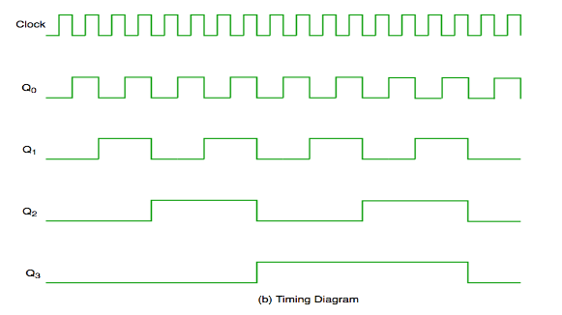
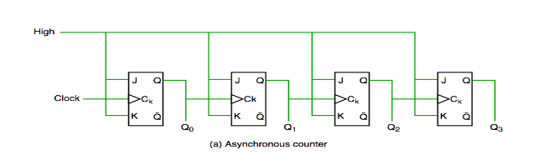
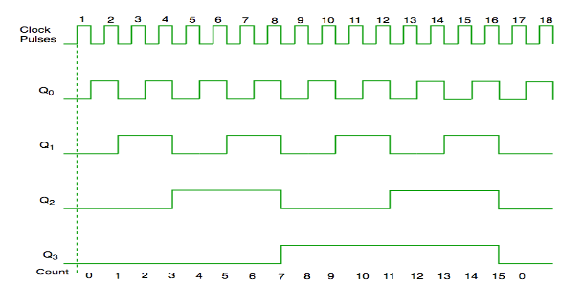
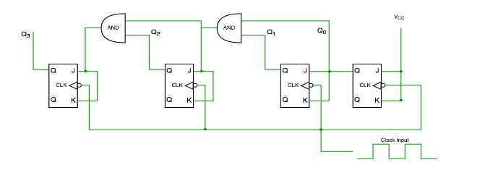
Synchronous counter: Unlike the asynchronous counter, synchronous counter has one global clock which drives each flip flop so output changes in parallel.Advantage of synchronous counter over asynchronous counter is, it can operate on higher frequency than asynchronous counter as it does not have cumulative delay because of same clock is given to each flip flop.
13

Slide 14
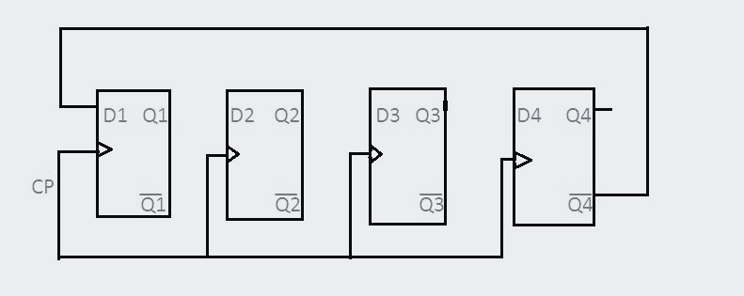
Counter classification based on directions:
Up counters
Down counters
Up/Down counters
Some special counters such as :
Ring Counters
Johnson’s Counter/Twisted/Switch tail ring counter
14
Fig: Johnson’s Counter

Slide 15
s
Registers
What Are Registers?
A register is basically a storage space for units of memory that are used to transfer data for immediate use by the CPU (Central Processing Unit) for data processing. Also known as memory registers, they can actually form part of the computer processor as a processor register. It is large enough to hold any kind of data, such as dates, instruction sets, storage addresses, bits, sequences, and characters. Some instruction sets are partly formed by registers. Types of registers include memory address register, memory buffer register, input output address register, input output buffer register, and shift register. In this presentation we will be focusing on shift registers.
15

Slide 16
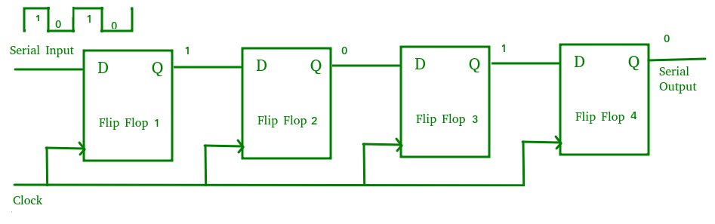
Types of Shift Registers:
Serial In Serial Out shift register(SISO)
Serial In parallel Out shift register(SIPO)
Parallel In Serial Out shift register(PISO)
Parallel In parallel Out shift register(PIPO)
Bidirectional Shift Register
Universal Shift Register
Shift Register Counter
Serial-In Serial-Out Shift Register (SISO):The shift register, which allows serial input (one bit after the other through a single data line) and produces a serial output is known as a Serial-In Serial-Out shift register
16

Slide 17
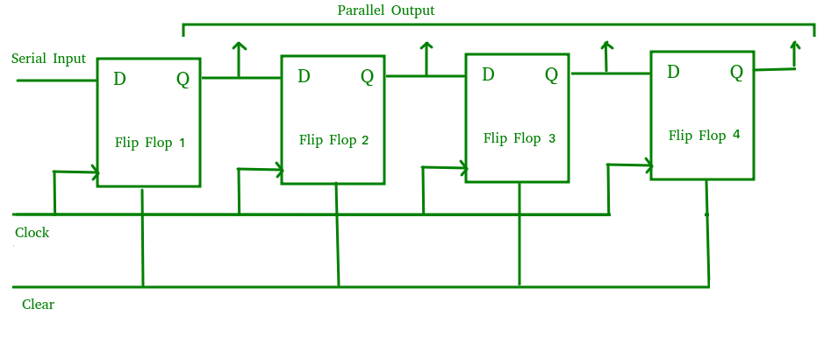
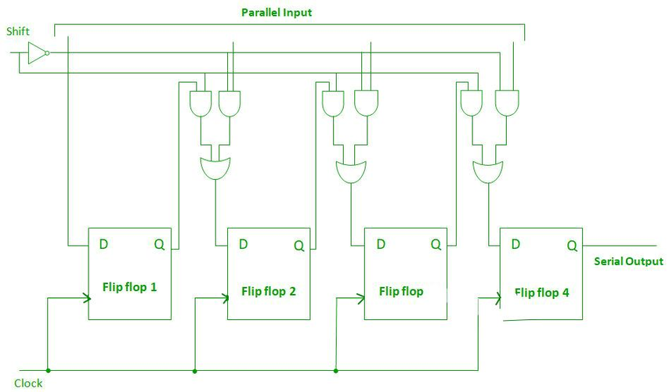
Serial-In Parallel-Out Shift Register (SIPO):The shift register, which allows serial input (one bit after the other through a single data line) and produces a parallel output is known as the Serial-In Parallel-Out shift register.
Parallel-In Serial-Out Shift Register (PISO):The shift register, which allows parallel input (data is given separately to each flip flop and in a simultaneous manner) and produces a serial output is known as a Parallel-In Serial-Out shift register
17

Slide 18
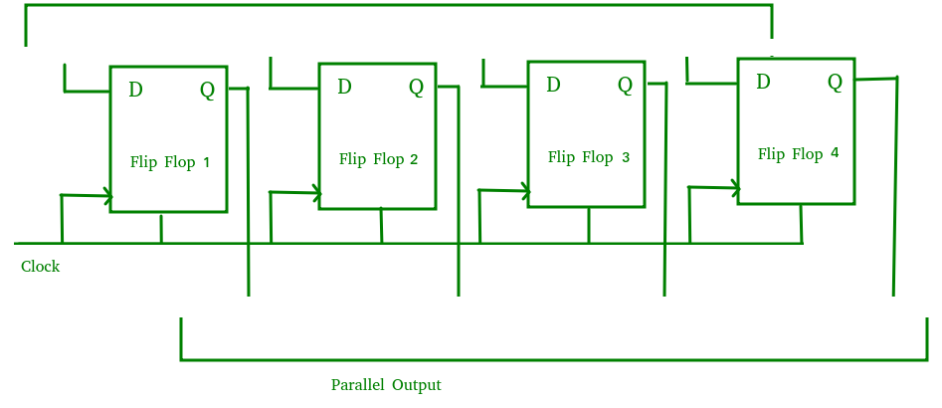
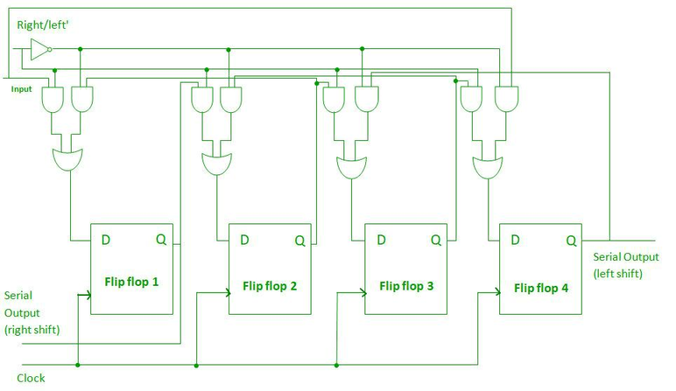
Parallel-In Parallel-Out Shift Register (PIPO):The shift register, which allows parallel input (data is given separately to each flip flop and in a simultaneous manner) and also produces a parallel output is known as Parallel-In parallel-Out shift register.
Bidirectional Shift Register:Bidirectional shift registers are the registers that are capable of shifting the data either right or left depending on the mode selected. If the mode selected is 1(high), the data will be shifted toward the right direction and if the mode selected is 0(low), the data will be shifted towards the left direction.
18

Slide 19
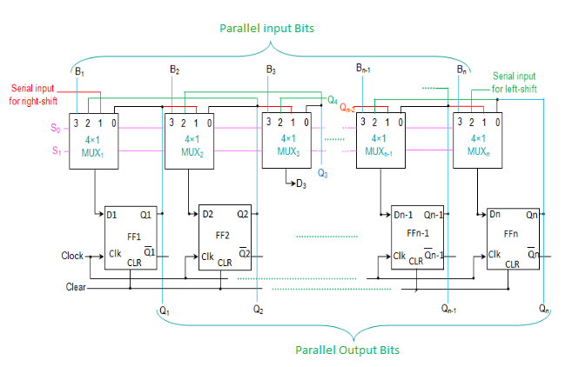
Universal Shift Register:Universal Shift Register is a type of register that contains the both right shift and the left shift. It has also parallel load capabilities.
19

Slide 20
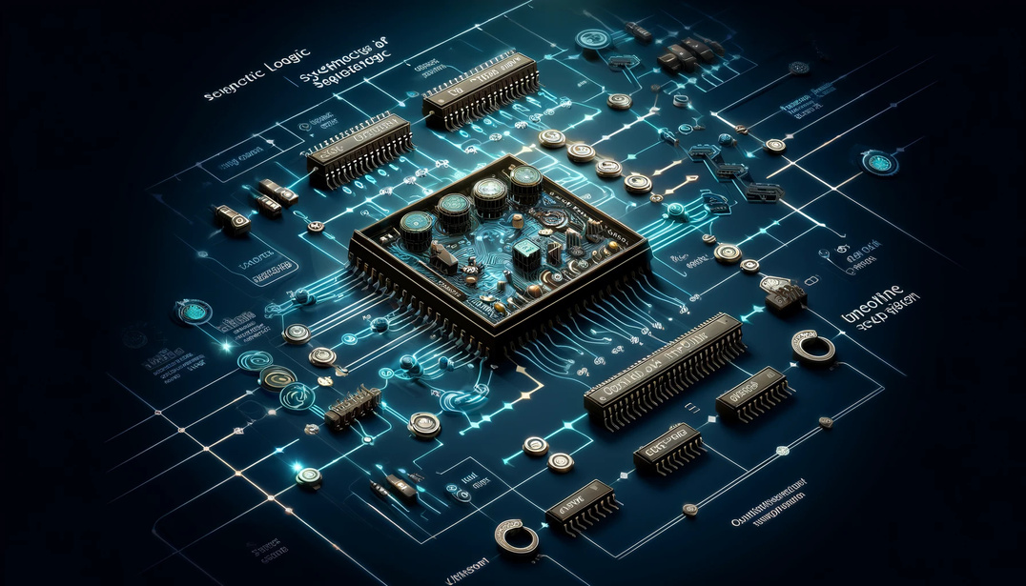
s
Conclusion
Synchronous sequential logic forms the backbone of modern digital systems, leveraging clock signals and storage elements like flip-flops, counters, and registers to enable controlled and reliable data processing. Applications, ranging from memory design to complex state machines, highlights its importance in advancing technology. Understanding these foundational components equips us to design efficient and innovative digital circuits.
20

Slide 21
References
Books
Digital Design by M. Morris Mano and Michael D. Ciletti
Digital Fundamentals by Thomas L. Floyd
Fundamentals of Digital Logic with Verilog Design by Stephen Brown and Zvonko Vranesic
Modern Digital Electronics by R.P. Jain
Web Resources
All About Circuits - Sequential Circuits
https://www.allaboutcircuits.com
GeeksforGeeks - Sequential Circuits
https://www.geeksforgeeks.org
Electronics Tutorials - Flip-Flops and Counters
https://www.electronics-tutorials.ws
TutorialsPoint - Digital Circuits
https://www.tutorialspoint.com
21

Slide 22
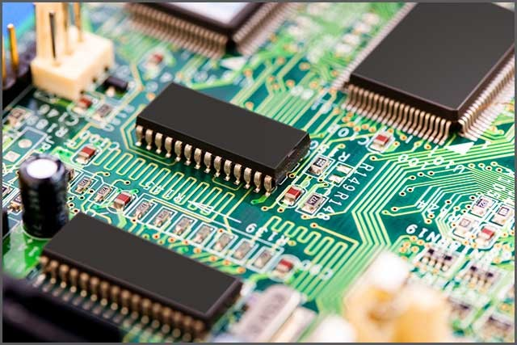
Thank you for your patience!
22

